Slide 1

How Much Do Data Practitioners Get Paid?
Tracing the Ceiling of Technical and Geographic Compensation
Mei Qi Ng | FALL 2026 DATA 608: Story 4
Notes:
Story Development Focus:
Visual and Slide Messaging. By using Tufte's data-ink principles (removing spines/gridlines), red color attributes, and labeling, I was able to reduce cognitive load and ensure viewer amity and show salient information

Slide 2
Selection framework: Role and Geography
Chart 1 Bar charts
(Macro & Micro) —
Direct baseline salary comparison across broad and specific specializations
Chart 2 Box Plots Distributional analysis revealing income ceilings by role
Chart 3 Dot Plot
Geographic salary variation highlighting the top tech hubs
Chart 3 Range Plot
State distribution ceilings and the ultimate compensation multiplier
My goal is to make compensation ceilings and baseline disparities among data practitioners immediately visible without cognitive effort

Slide 3
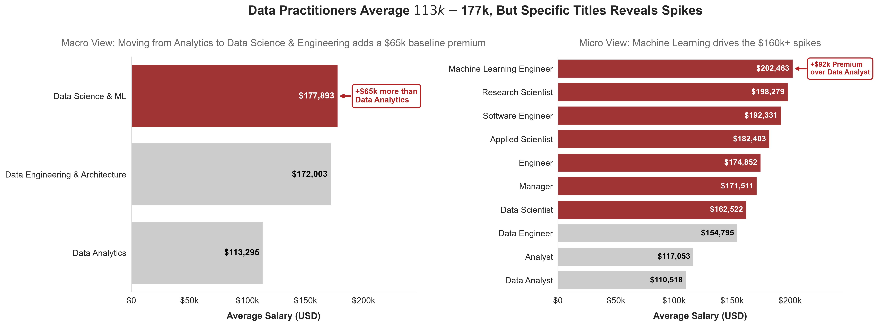
Core Message:
Deconstruct the Baseline - Grouping titles shows that Data Science and Engineering has a higher baseline increase over Analytics. Zooming in on the 10 most frequent specific titles proves this and reveals how the shift from “Data Analyst “ to “Data Architect” triggers massive salary jump in compensation
Date Source: Kaggle Global Data Science Salaries (2025 US Filter)
Notes:
I selected a Horizontal Bar Chart because it is the most efficient visual for comparing the 3 categorical amounts. It allows the long role descriptions to stay readable without modification to the axis

Slide 4
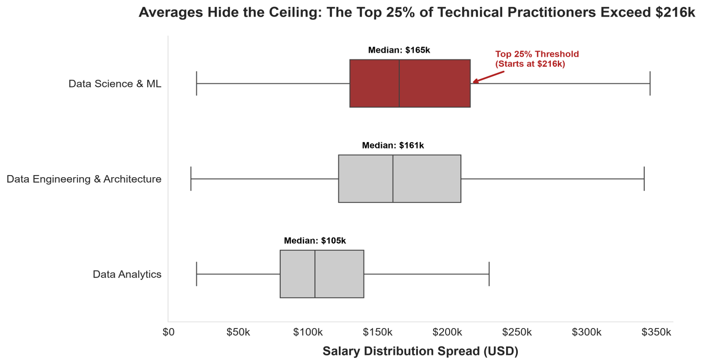
Core Message:
True Ceiling - Averages does not show true income potential. The highest earners in specialized technical roles push the ceiling well beyond $200k, creating huge compensation variation within the profession itself.
Date Source: Kaggle Global Data Science Salaries (2025 US Filter)
Notes:
I selected a box plot to visualize the variance and address it and a box plot reveals the hidden upper ceiling of the profession compared to the bar plot just showing baseline

Slide 5
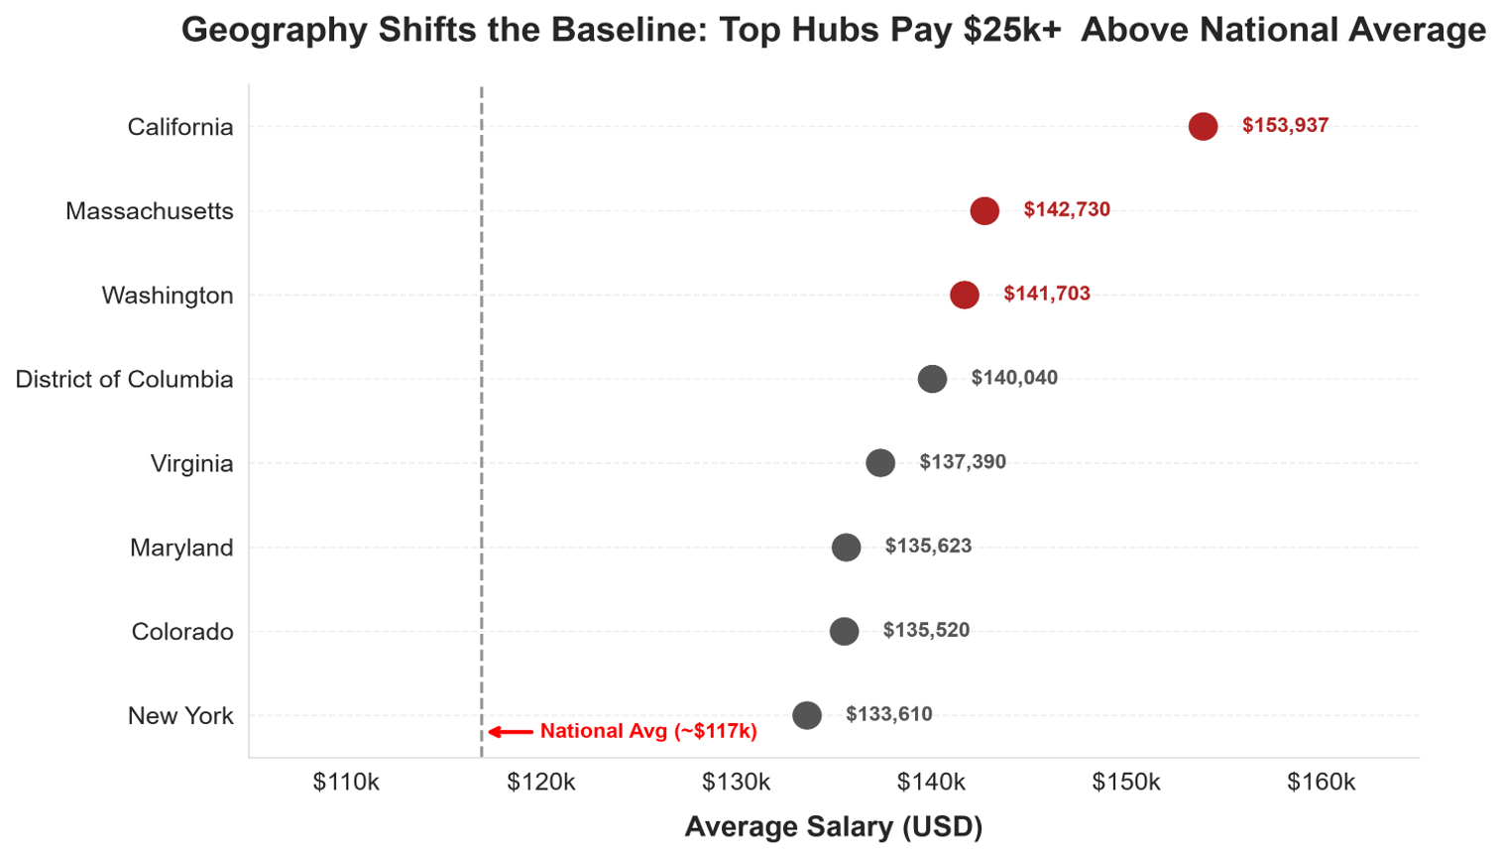
Core Message:
Geographic Multiplier – Job Role is only half the equation. Audited tax data reveals that relocating to a tier-one tech market like California, Massachusetts, or Washington acts as a geographical multiplier on base pay.
Date Source: Source: US Bureau of Labor Statistics (BLS) OEWS State Data May 2025 (SOC 15-2051, 15-1243, 15-1211
Notes:
I chose a Cleveland dot pot to maximize the data ink ratio. Dot plots emphasize relative position and draws the eye to the $25k wage gap difference, without the clutter of heavy bars.

Slide 6
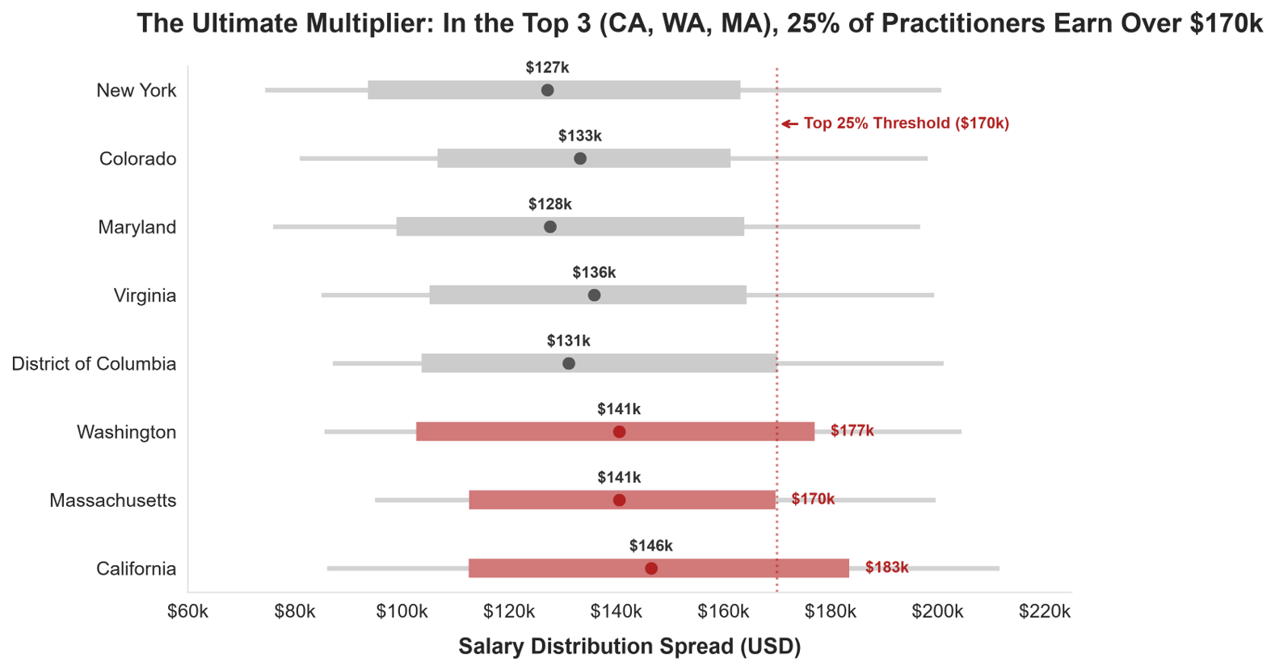
Core Message:
Ultimate Equation - Max compensation requires securing a high leverage data practitioner title and anchoring it to the top market. In these elite hubs, the 75th percentile of base pay alone pushes past $170,000.
Date Source: Source: US Bureau of Labor Statistics (BLS) OEWS State Data May 2025 (SOC 15-2051, 15-1243, 15-1211
Notes:
I used a range plot. It acts as a minimalist box plot designed to show distribution spread while stripping away heavy borders, focusing the viewer on the $170k threshold only

Slide 7
Final ANSWER: how much do we actually get paid
Key Takeaways:
ANSWER: Compensation for Data Practitioners cannot be captured by a single national average.
It is a compounding equation: Specific Technical Leverage + Geographic Anchoring = Maximum Income Potential
Specialization Floor: Analytics serves as the baseline. Moving into higher macro-roles (Data Science/Engineering) adds $65k, driven by titles like Data Architect and MLEngineer which push base averages past $160,000
Geographic Multiplier: Geography acts as a rigid multiplier. Audited government tax data proves that coastal hubs (California, Washington, Massachusetts) shift the entire baseline $25,000+ above the national average
Ceiling: Averages hide the ceiling. High paid titles stacked within a top tier geographic market, the top 25% of practitioners break through the $170,000 to $216,000 threshold in base pay alone

